Slide 1
Product & Market Analysis for H&M
Team Members: Shubhang Seth, Sumedh Nikhil Shah

Slide 2
Recommendations
H&M should aim at selling higher priced products - above 75 percentile of category price - during the last quarter, Sep-Dec.
40% of H&M’s customers are aged between 20-30 and tend to buy products which are cheaper. H&M must focus on strengthening this segment and increasing customer loyalty.
Black is the most favorable color for experimentation with design and styles.
H&M has a stronger online sales channel and must focus on increasing operational efficiency to maximise margins.

Slide 3
Introduction

Slide 4
Motivation
Inquisitiveness to understand business processes from a perspective of a big brand.
Analyzing impact of COVID on consumer behavior.
Background in startups encouraged evaluation of business models.
Applying data science skills to work with large scale datasets.

Slide 5
Dataset
H&M has released a recommendation competition on Kaggle, for which they have made public their transactional data from years 2018, 2019 and 2020.
The dataset consists of three csv files with the following useful information:
articles.csv - Article Id, Product Category, Color
customers.csv - Customer Id, Age, Postal Code
transactions_train.csv - Date of txn, Customer Id and Article Id
* Some other columns were also provided which were not used for our analysis and are not mentioned above.

Slide 6
Exploratory Data Analysis

Slide 7
Core Questions
Finding Trends with Prices:
How do prices of products change according to category?
Which months are good for selling higher priced products?
Demographic Analysis:
Are there any locations where H&M performs better compared to others?
What is the age range of H&M customers and what are their buying patterns?
Segmentation Analysis:
What segment of products should H&M allow experimentation with(new styles/designs etc)?
Sales Channel Analysis:
How should H&M sells its products?

Slide 8
Finding Trends with Prices

Slide 9
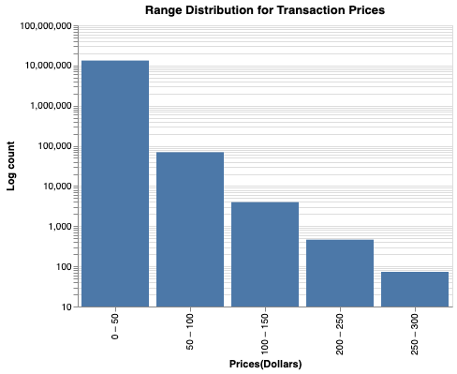
Price distribution range
Follows Long-tail distribution, which is expected.
$0 - $50 seems to be the core market segment for H&M.

Slide 10
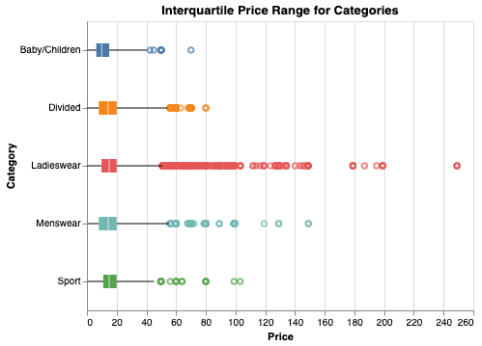
Price range per category
Similar Interquartile range observed for all categories.
Number of outliers are more in the case of Ladieswear. Potential category to sell higher priced products.

Slide 11
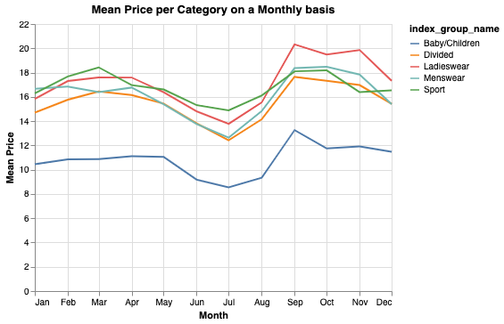
Price fluctuation over an year
Category prices follow seasonal patterns.
Customers have higher purchasing power during the months of Sep-Dec which leads to higher mean price.

Slide 12
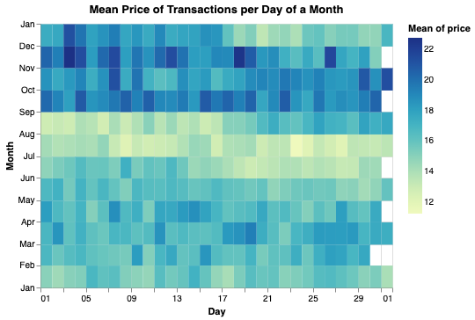
Mean price per day of a month
Customers tend to buy higher priced products during the first 2 weeks in last quarter.
Purchasing patterns resemble gift buying patterns for Christmas, Thanksgiving etc.

Slide 13
Demographic Analysis

Slide 14
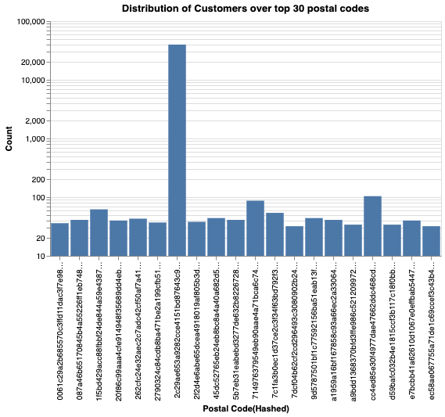
Customer geographic discovery
Postal codes provided as hashed values for privacy concerns.
Approx 40,000 customers belong to the same postal code - Weird.

Slide 15
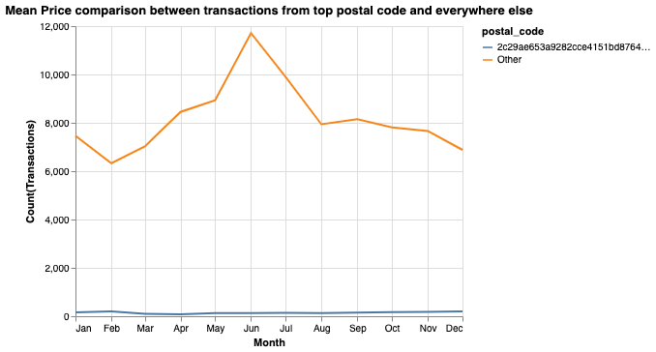
Analysing transactions for the 40k customers
Location with most customers doesn’t own majority of transactions.
Postal code doesn’t have a direct correlation with sales.

Slide 16
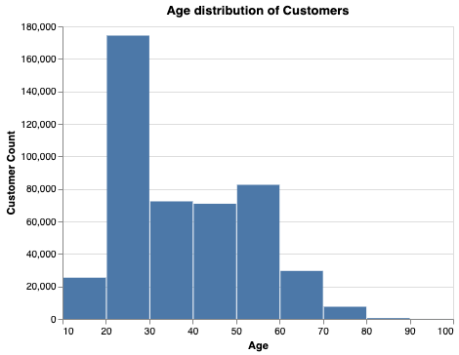
Analysing customer age
Most H&M customers are in the 20-30 age group.
Do these customers have control most of the sales?

Slide 17
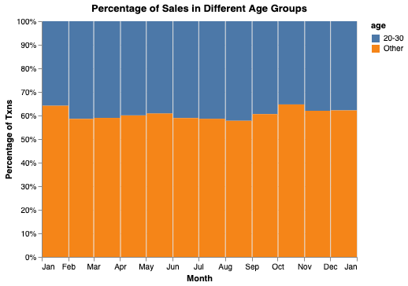
Sales portion for customers aged 20-30
Approximately 40% of the monthly sales are done by customers aged 20-30.
Huge market potential. H&M should focus on increasing customer loyalty for this segment.

Slide 18
Segmentation Analysis

Slide 19
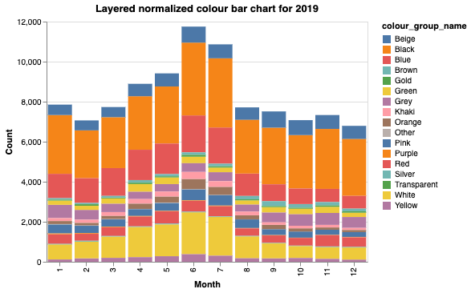
Color Choices
Black is the most bought color.
H&M can use black color as a medium of experimentation with designs and styles.

Slide 20
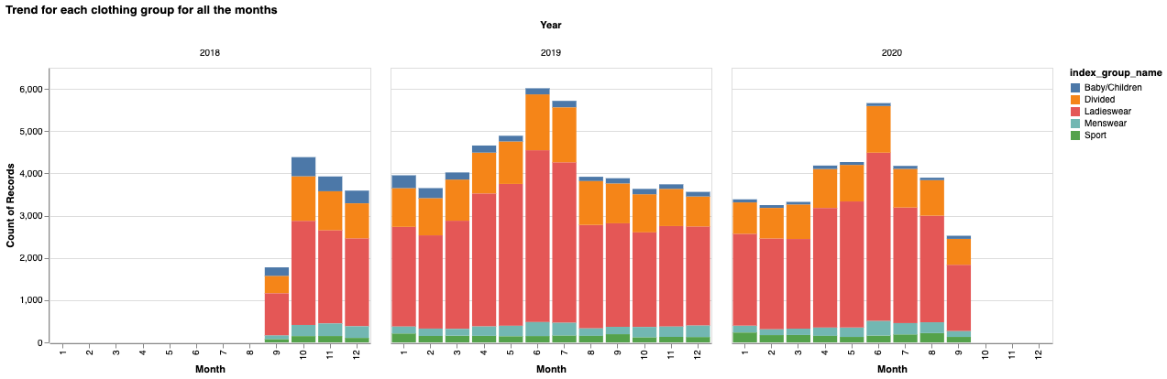
Trending Categories
Ladieswear is the most sold category across months.

Slide 21
Sales Channel Analysis

Slide 22
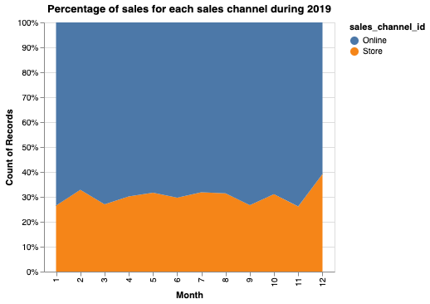
Online vs Offline
Online channels count for more than 60% of the sales, year-round.
Offline sales tend to shoot up during the months of Nov and Dec, correlated to Holiday shopping.

Slide 23
Conclusion

Slide 24
Recommendations
H&M should aim at selling higher priced products - above 75 percentile of category price - during the last quarter, Sep-Dec.
40% of H&M’s customers are aged between 20-30 and tend to buy products which are cheaper. H&M must focus on strengthening this segment and increasing customer loyalty.
Black is the most favorable color for experimentation with design and styles.
H&M has a stronger online sales channel and must focus on increasing operational efficiency to maximise margins.

Slide 25
Future Work
Finding dataset for H&M production cycles and evaluating profitability.
Exploring direct competitors of H&M and comparing their performance on the same metrics.

Slide 26

Thank You

